Slide 1
Employee management system
- BY TEAM PSEUDO-MAVERICKS

Slide 2
Project Description
Employee Management Software allows the company to organize their staff and record on an individual level.
There are HR and employee users in the system.
Employees can view their profile, access pay slips, report billing hours, apply leaves and view project hierarchy.
Additionally, HR users can track employees, approve leaves and assign employees to projects.

Slide 3
Development plan for phases
Phase 1:
Login and Registration
Create Database for project
Dashboard of employees and menu
Phase 2:
HR user features for project management and employee management
Leave Management and Timesheet submission
SQL procedures for project
Phase 3:
Build Payroll module
Generate pay slips for employees
System Testing and Integration Testing

Slide 4
Deliverables featured as part of Phase 2
HR user features for project management and employee management
Leave Management
Timesheet submission
SQL procedures for project

Slide 5
Minimum requirements to run the project
The list of instructions to run the project in their local/computer, the minimum requirements should be:
System specifications
Minimum of intel 5th generation or higher.
RAM: minimum of 4 GB.
Around 5GB of hard disk storage.
To construct the application, the user must first install an IDE (Integrated Development Environment). We prefer Eclipse or NetBeans.
Import the project repository into the IDE and configure the PHP connection.
On the local PC, install the PHP libraries.
Additionally, they must set up a XAMPP server on their PC.
After installation, they need to start the Apache server, MySQL database admin control panels using XAMPP.
After launching, it will navigate the phpMyAdmin console page, where we need to create a database according to the connection file in the project.
After the database has been created, we need to import the SQL file to the database from the appropriate folder location.
Then the user can access the application using their localhost URL.

Slide 6
Instructions to compile and run the application and its test classes.
Download the project zip file.
Can use GitHub to clone the repository using the below URL.
https://github.com/amarendhar-reddy/project-pseudo-mavericks.git
Extract the zip file.
Place the extracted files in XAMPP's htdocs folder.
In the IDE, create a workspace and import the project folder into it.
Configure the PHP to the workspace using the instructions below.
On the toolbar, go to the preferences area beneath the window section.
Select the Installed PHPs under the PHP section.
Add the name and PHP executable file.
Create a database in phpMyAdmin with the name “employee_ms”.
In the database, import the "employee_ms.sql" file.
To start as admin, set up the start page in the IDE's run configurations.
/employee_ms/login.php
Run the application and access the application using the localhost URL.
Ex: http://localhost/employee_ms/login.php#!
To run the test cases, we need to configure the PHPUnit in the IDE.
Navigate to the run configurations, Add the PHPUnit properties.
After adding it, run the application as a PHP unit test.

Slide 7
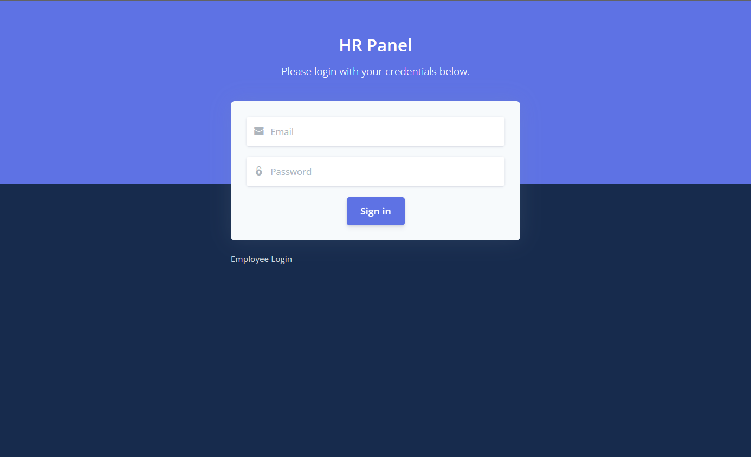
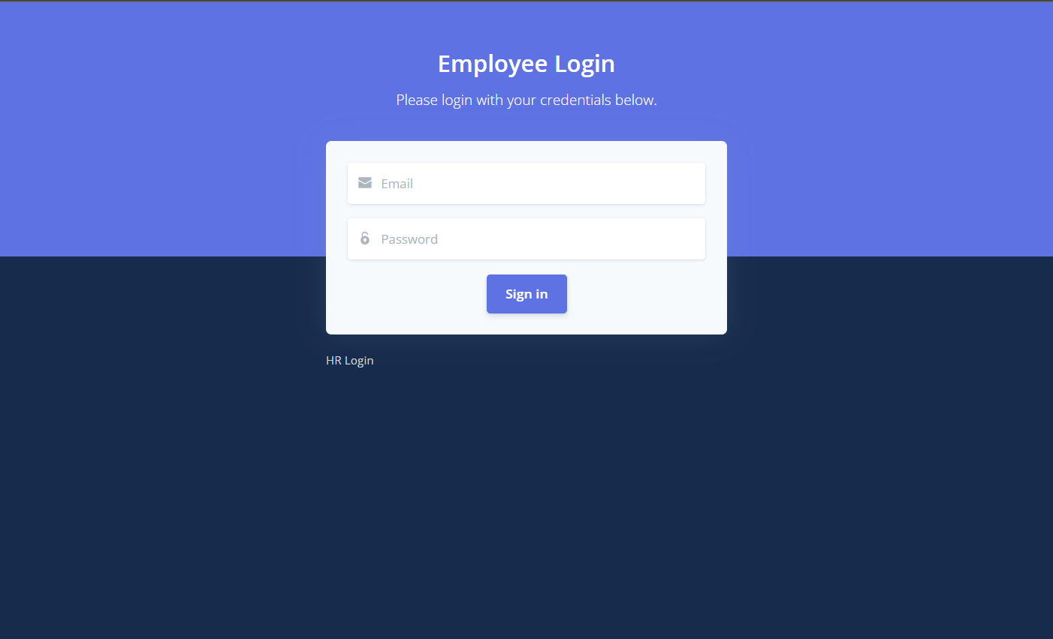
HR and Employee login screens
HR and employees are having different login screens.

Slide 8
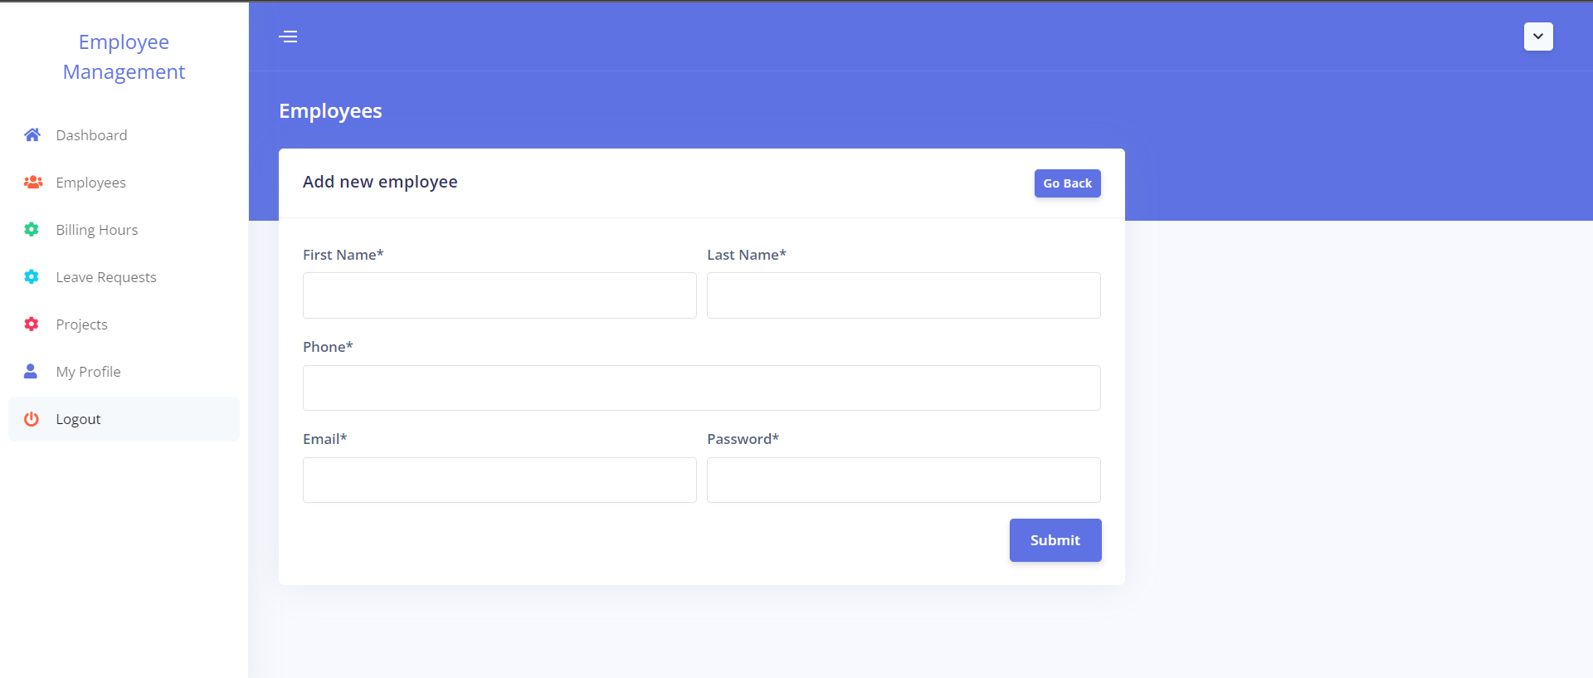
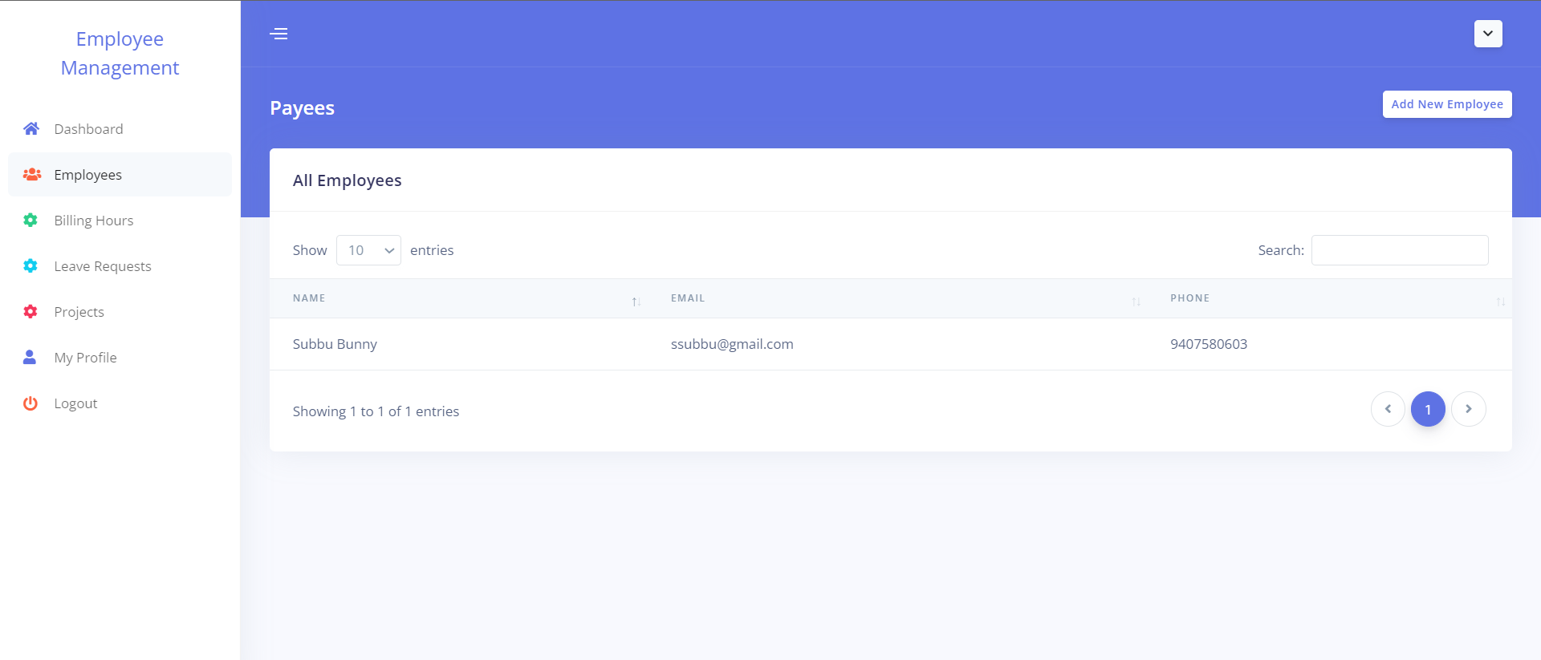
Employees
This panel is used to create new employees and view existing employees in the organization, which can be restricted to HR users only.

Slide 9
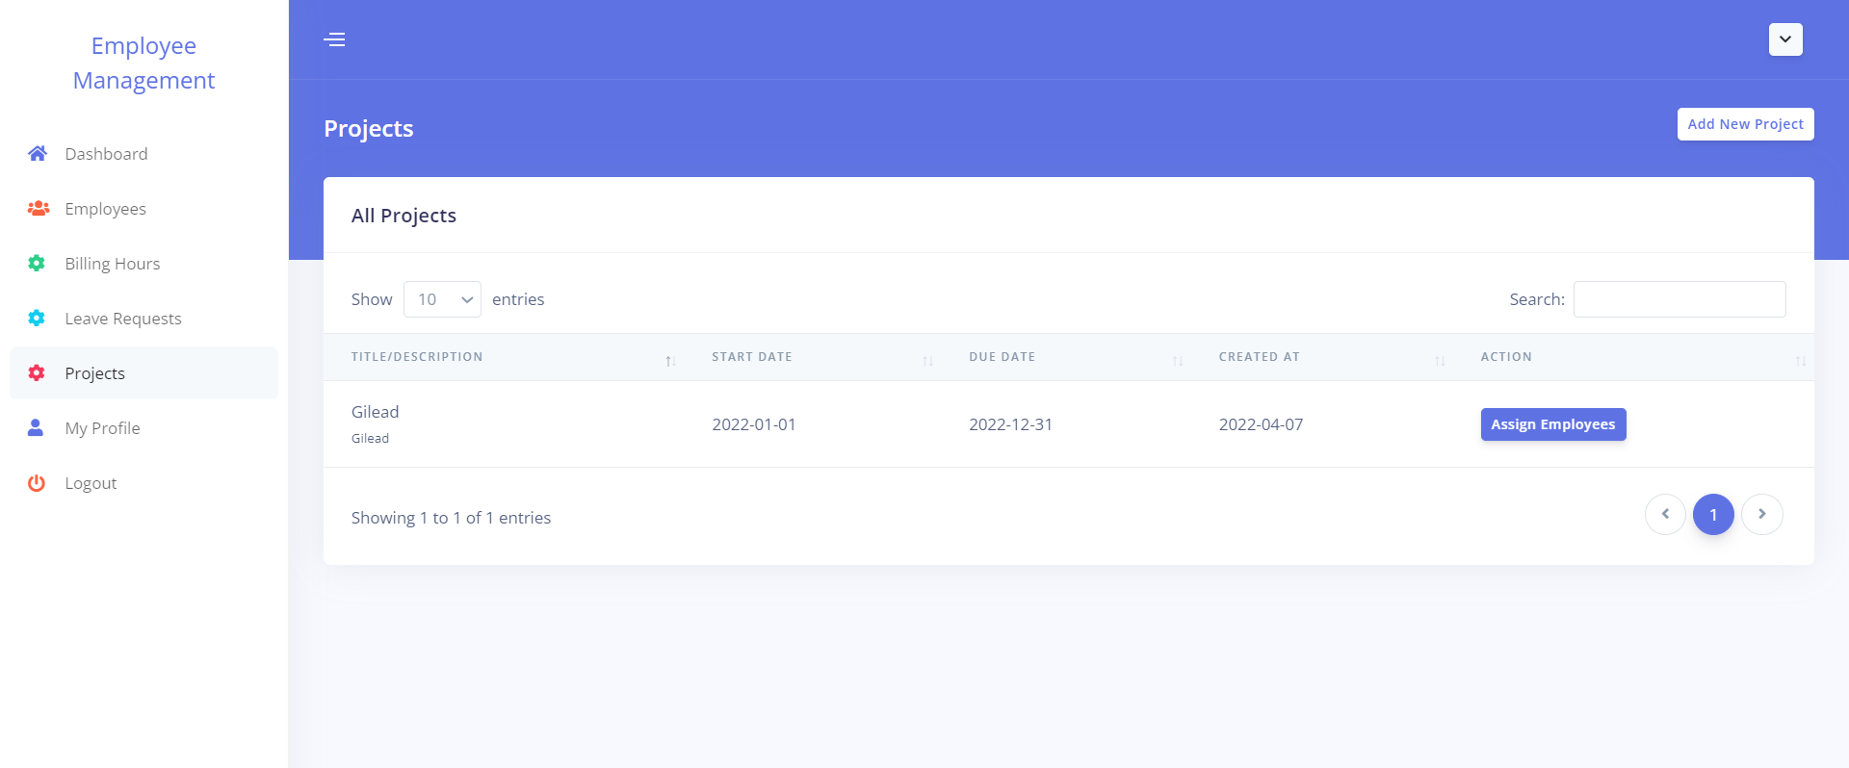
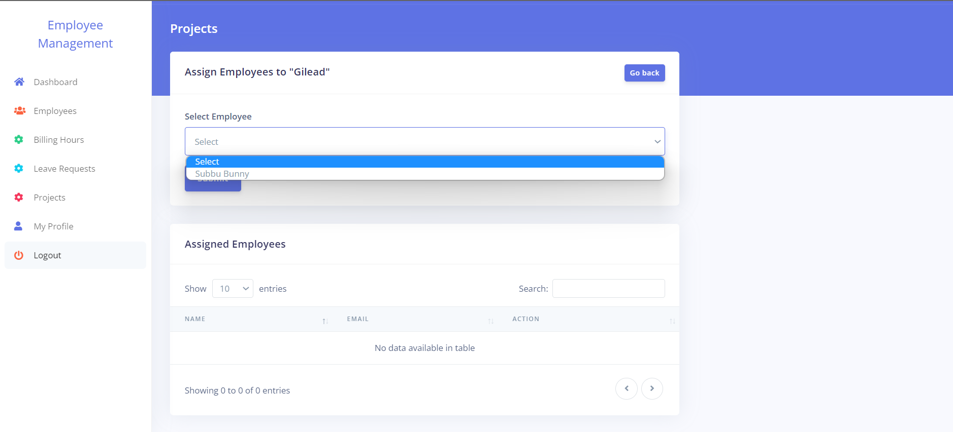
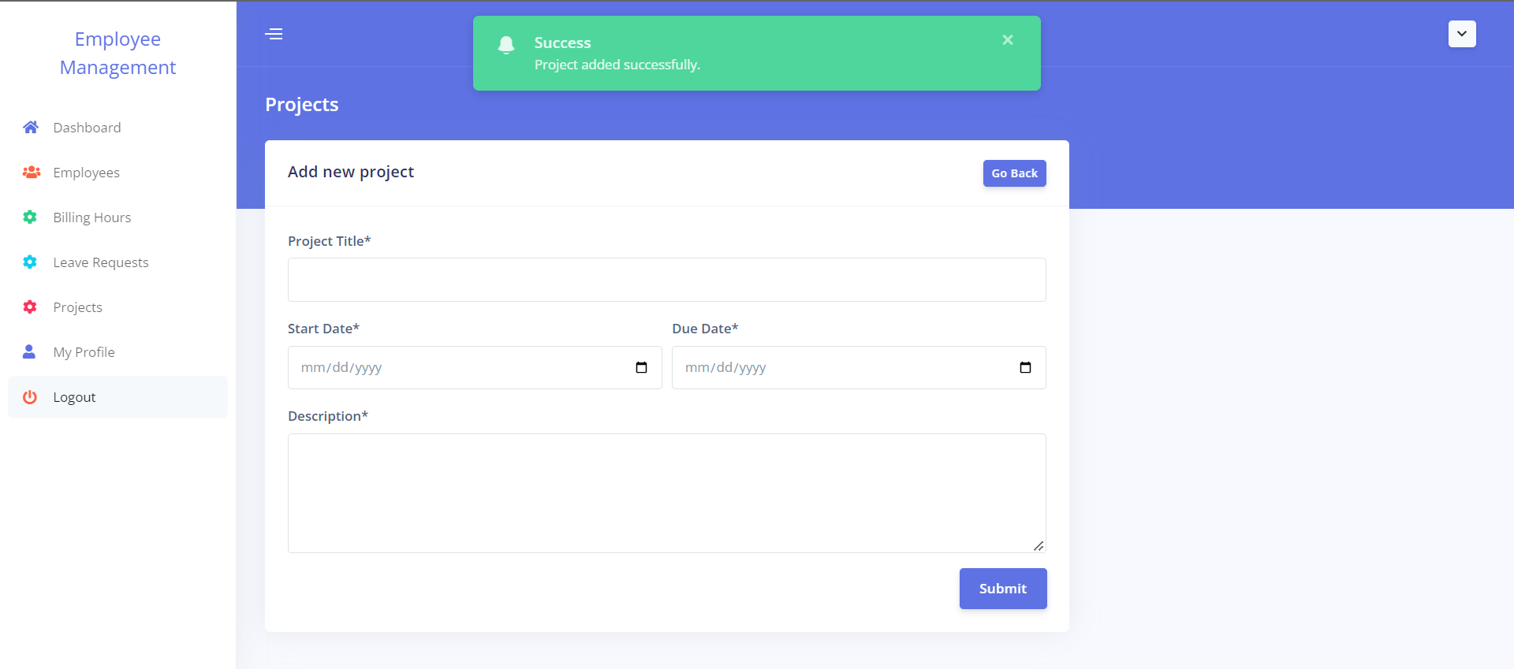
Projects
Only HR users have access to the projects panel, which is used to create projects, allocate employees, and project hierarchy.

Slide 10
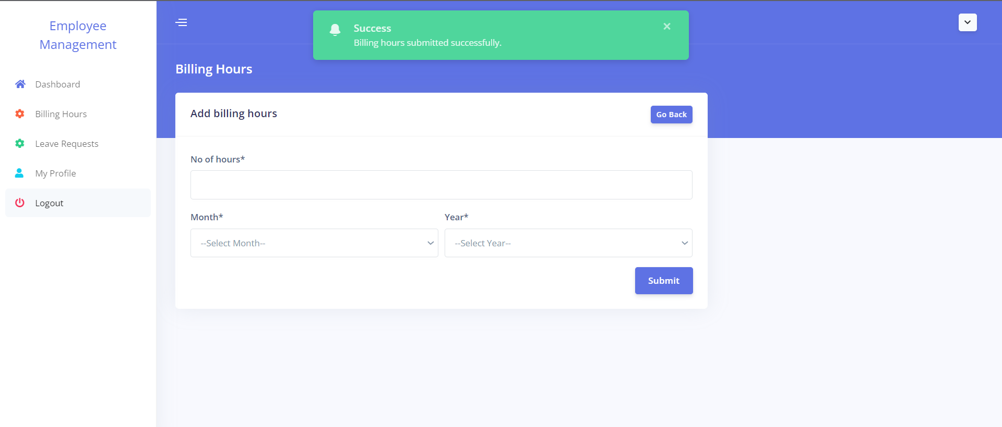
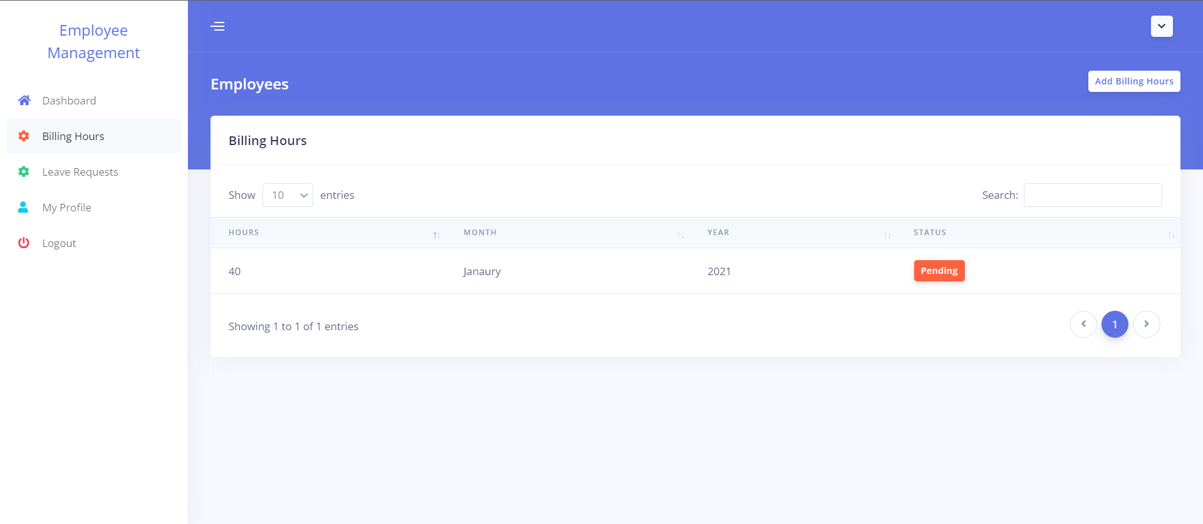
Billing Hours panel for employees
This is where the billing hours are created and submitted. They can also see a list of billing hours and their current status.
Once employees submit their billing hours, the request will be sent to HR.

Slide 11
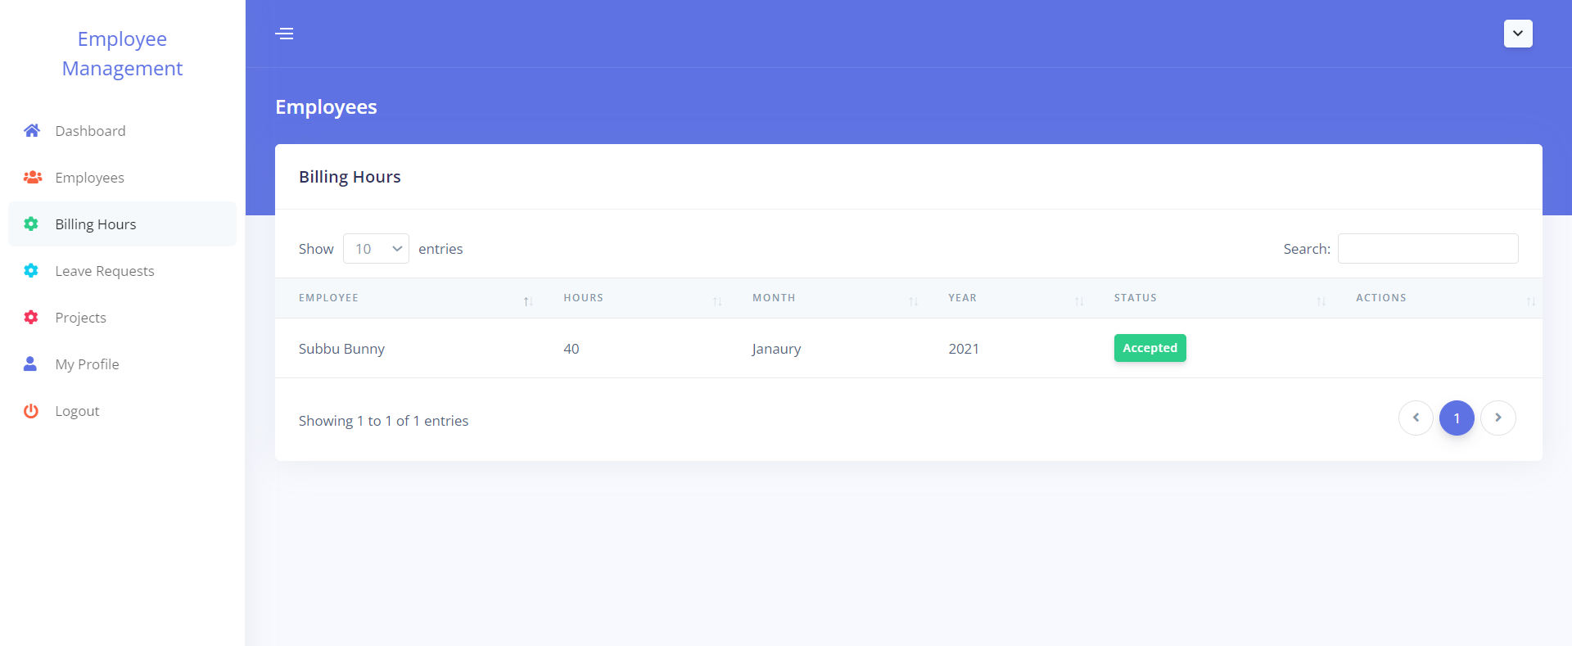
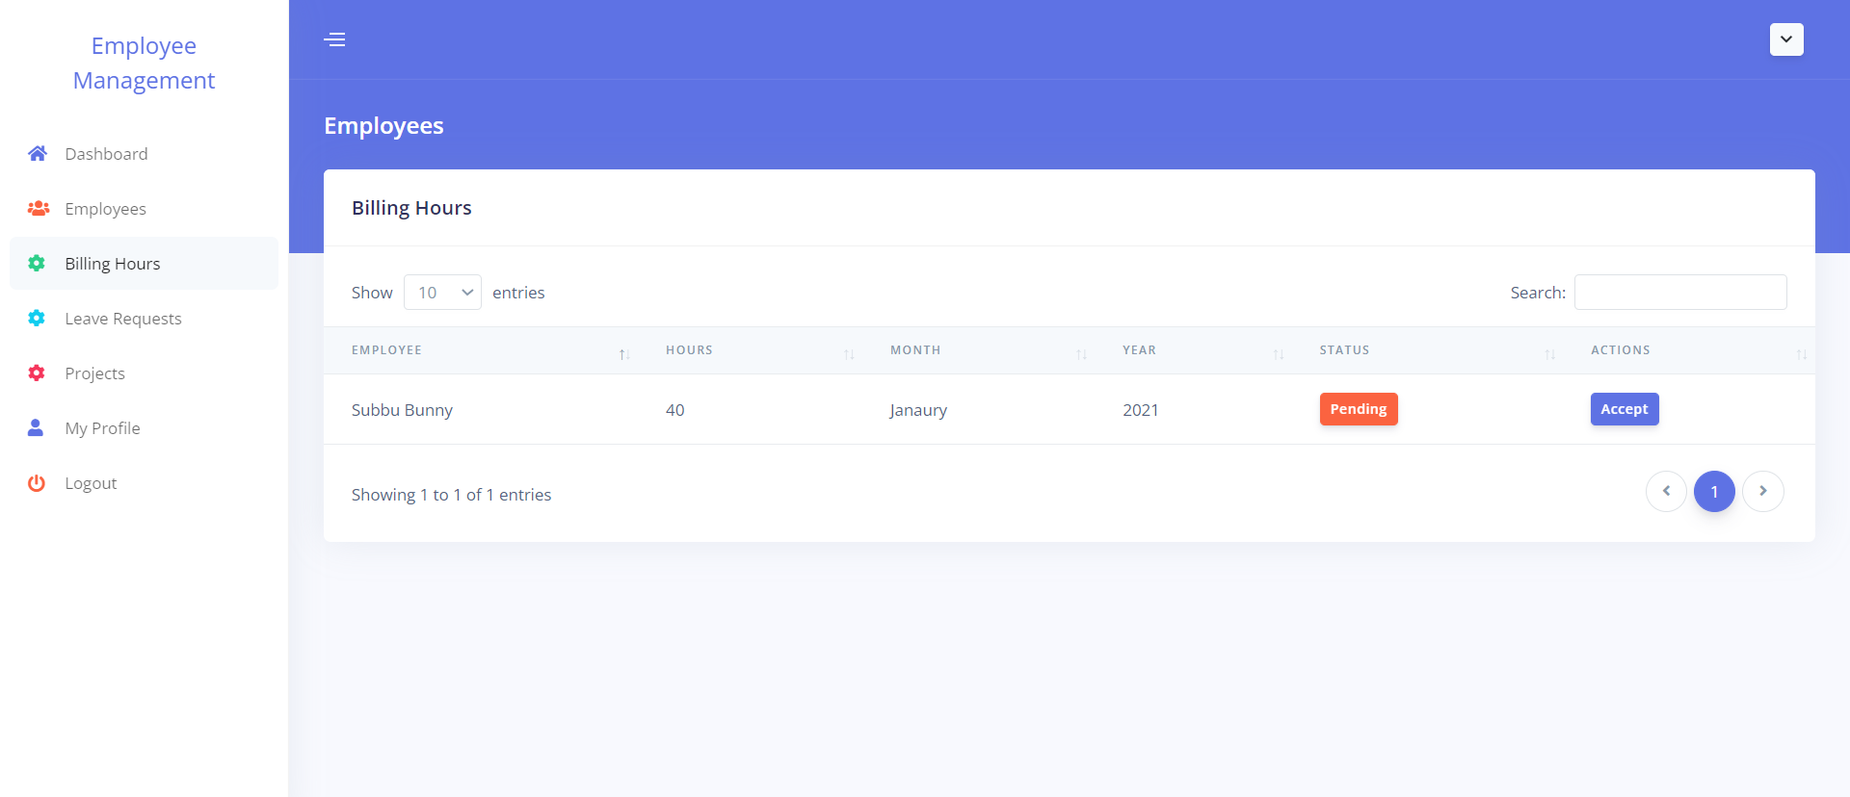
Billing hours panel for HR
HR can approve the billing requests submitted by employees and can view the status of the requests.

Slide 12
Leave Hours panel for employees
This is where the employee can create and submit timesheets. Also, can view the list of leave requests and their current status.
Once employees submit their leave requests, the request will be sent to HR.

Slide 13
Leave Hours panel for HR
HR can approve the leave requests submitted by employees and can view the status of the requests.

Slide 14
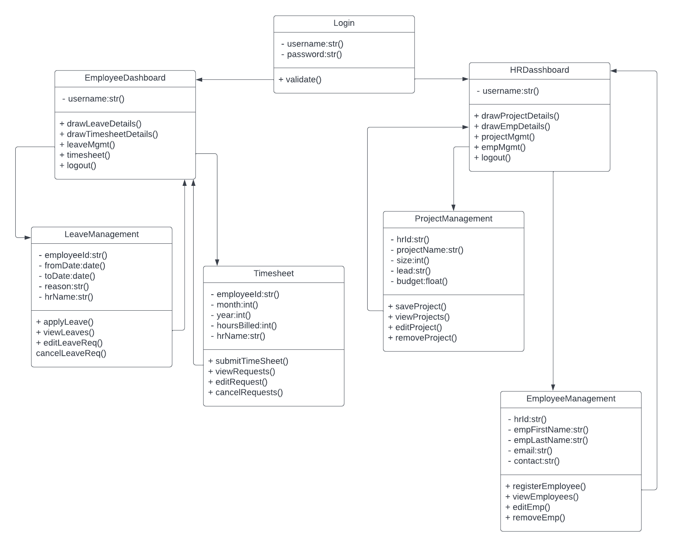
Class Diagram

Slide 15
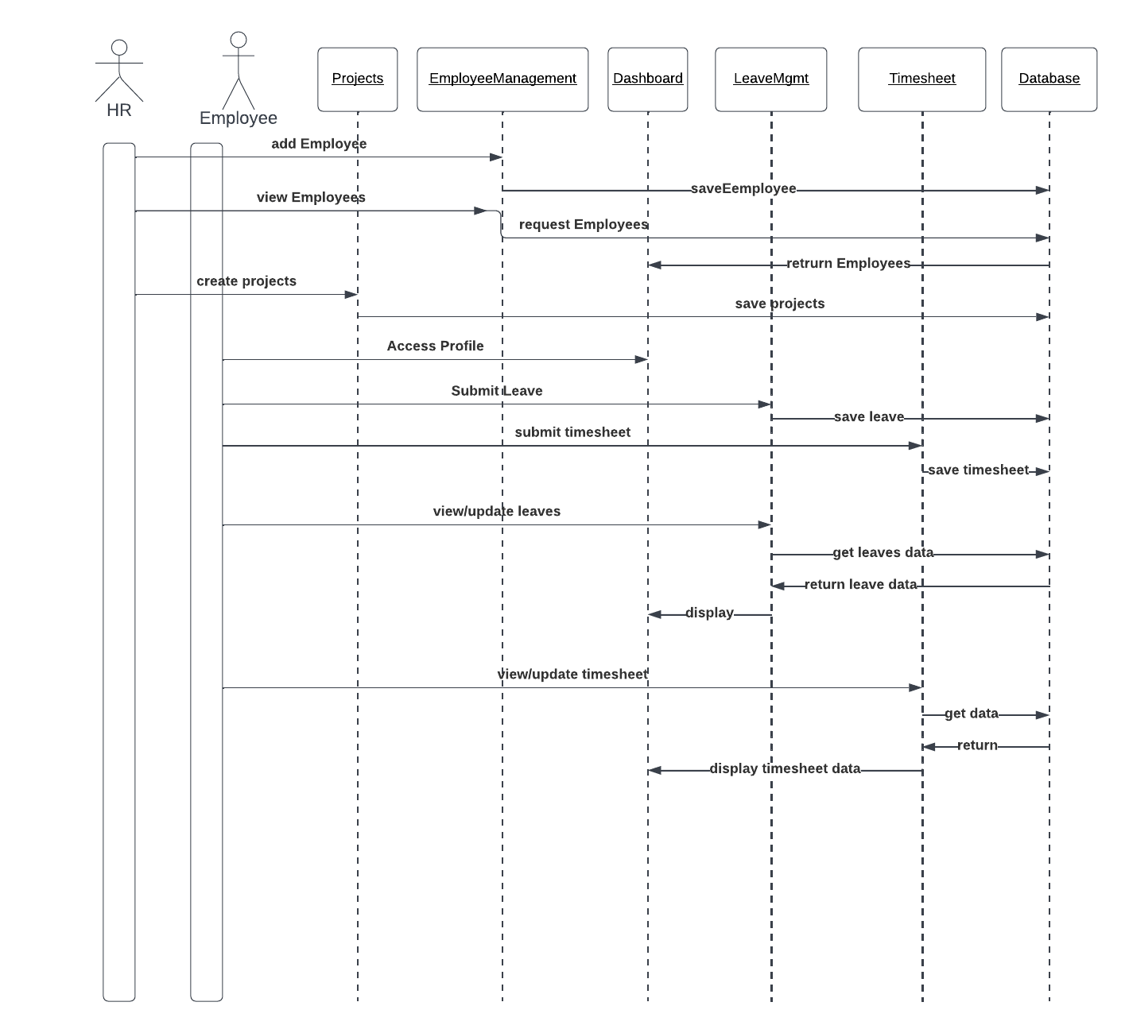
Sequence diagram

Slide 16
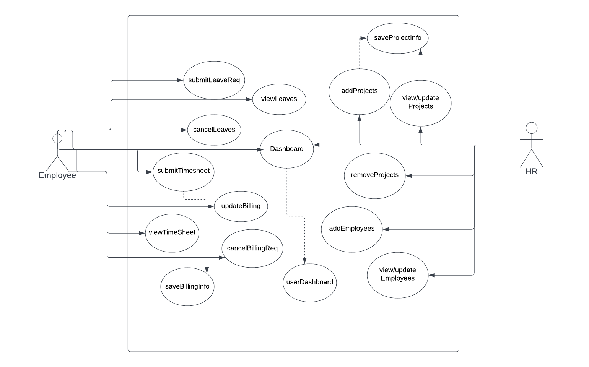
Use case diagram

Slide 17
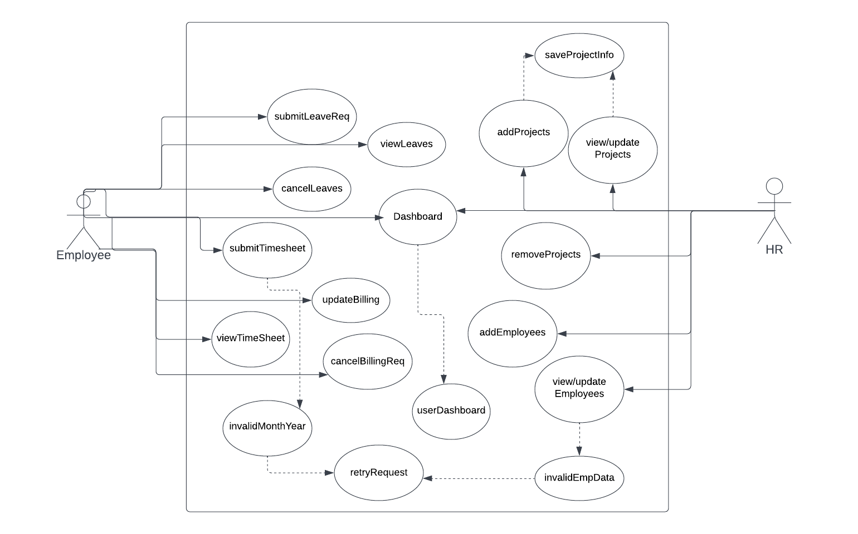
Use case diagram – Error Scenario

Slide 18
THANK YOU

